Slide 1
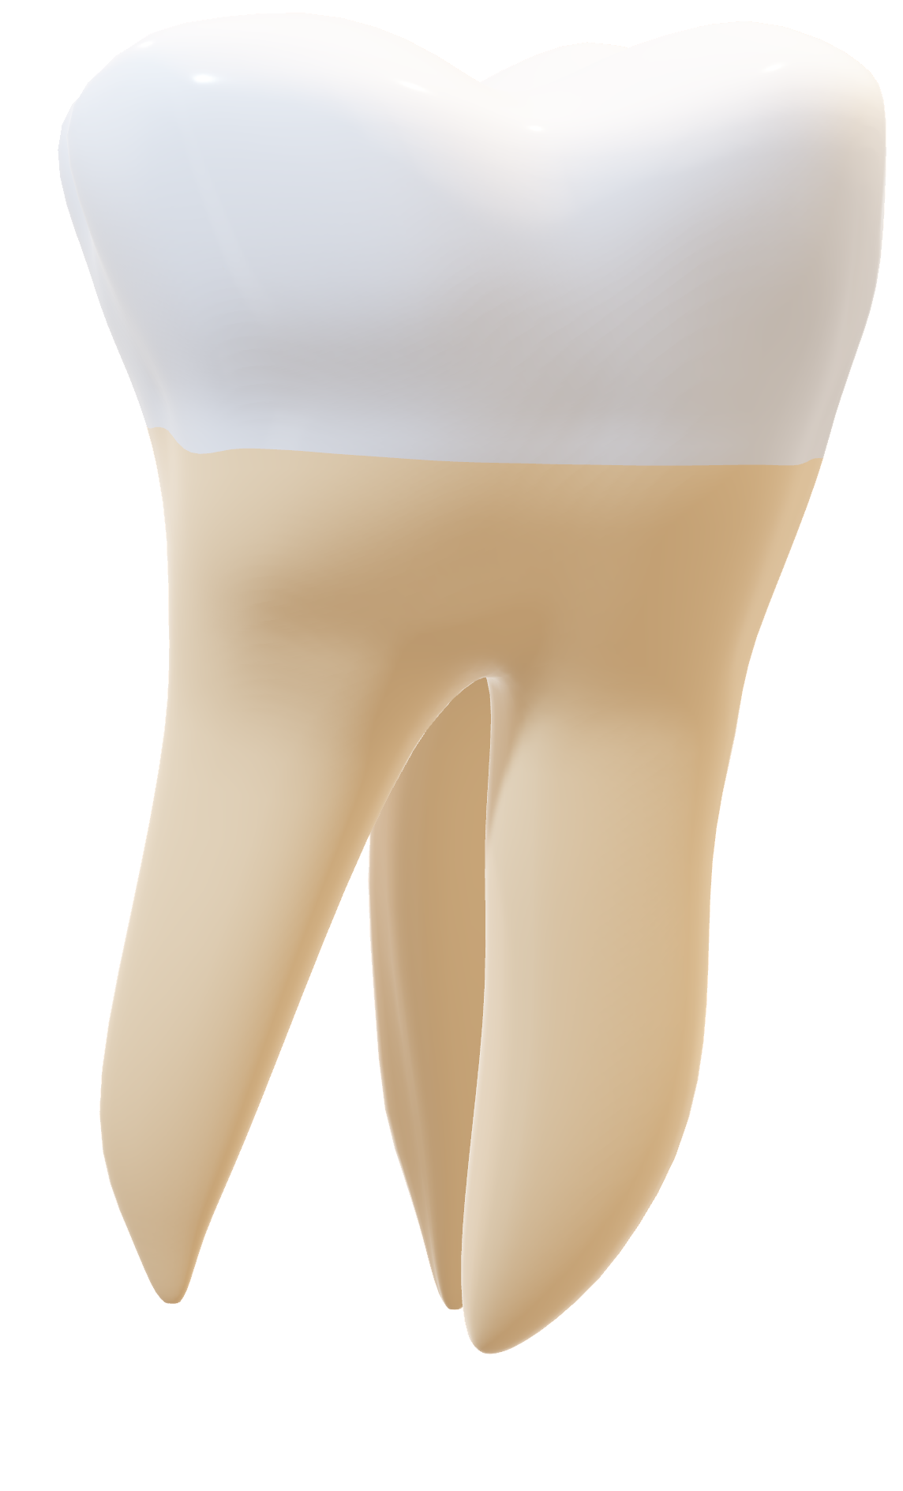

Thoutha
Let’s connect people

Slide 2
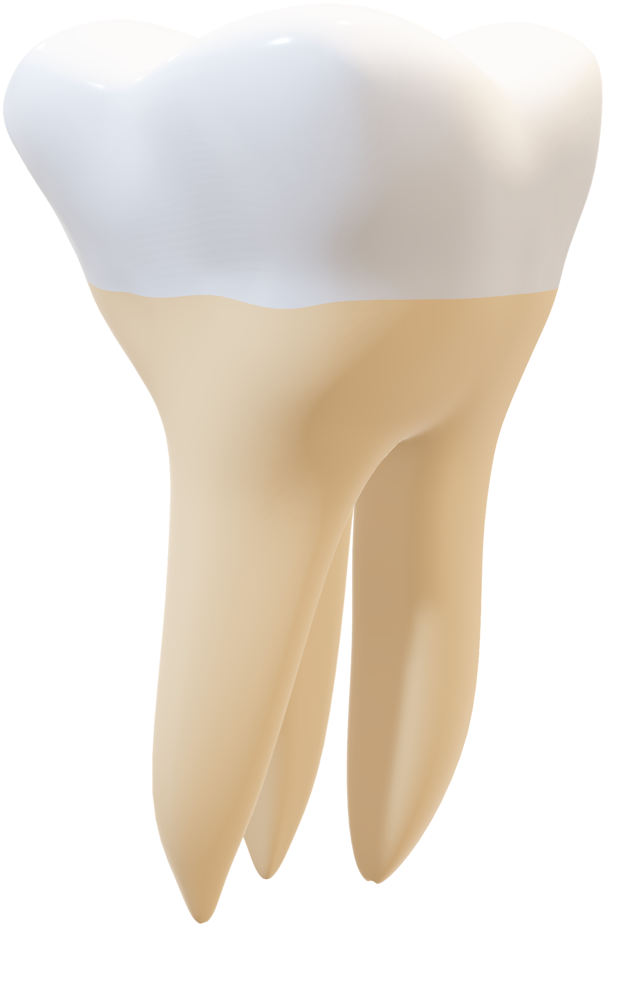

Omen Team

Slide 3

Team members:
Joesph George Wahba
Zeyad Saad Abdel-Fattah
Muhammed Ashraf Tawfeek
Zyad Gamal Saeed
Menna-Allah Ahmed
Abdelhalim Ramadan
Zeyad Muhamed Yehya

Slide 4
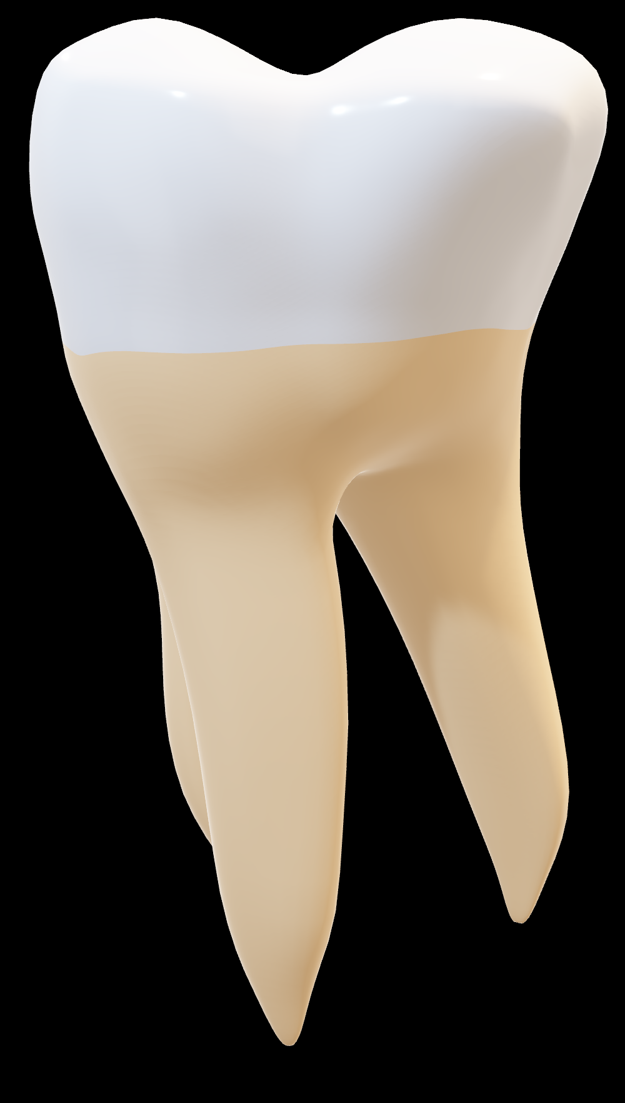
Executive Summary:
About the Project
Aims to design and develop a digital platform (mobile & web application) that connects Dental Students with Patients who need affordable dental care.
The system will serve as a mutual benefit bridge:
Patients: gain access to low-cost or free dental services, while maintaining trust through faculty supervision.
Students: gain valuable hands-on experience by working on real cases, supported by structured scheduling, patient feedback, and digital case tracking

Slide 5
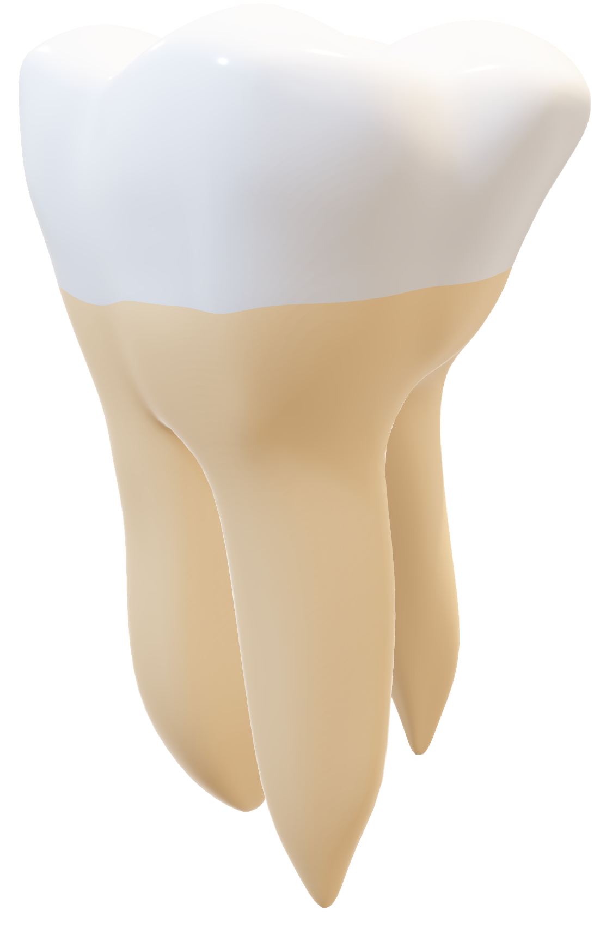
Key Objectives:
Provide accessible and affordable dental services for patients.
Enable students to practice, learn, and improve skills before graduation.
Ensure secure, easy, and professional communication between both parties.
Collect feedback and generate insights to improve healthcare quality.
Why It Matters?
Tackles the challenge of limited patient access to affordable dental care.
Empowers students with practical exposure under supervision.
Bridges the gap between academia and real-world practice.
Supports the college’s mission in community service & innovation.

Slide 6
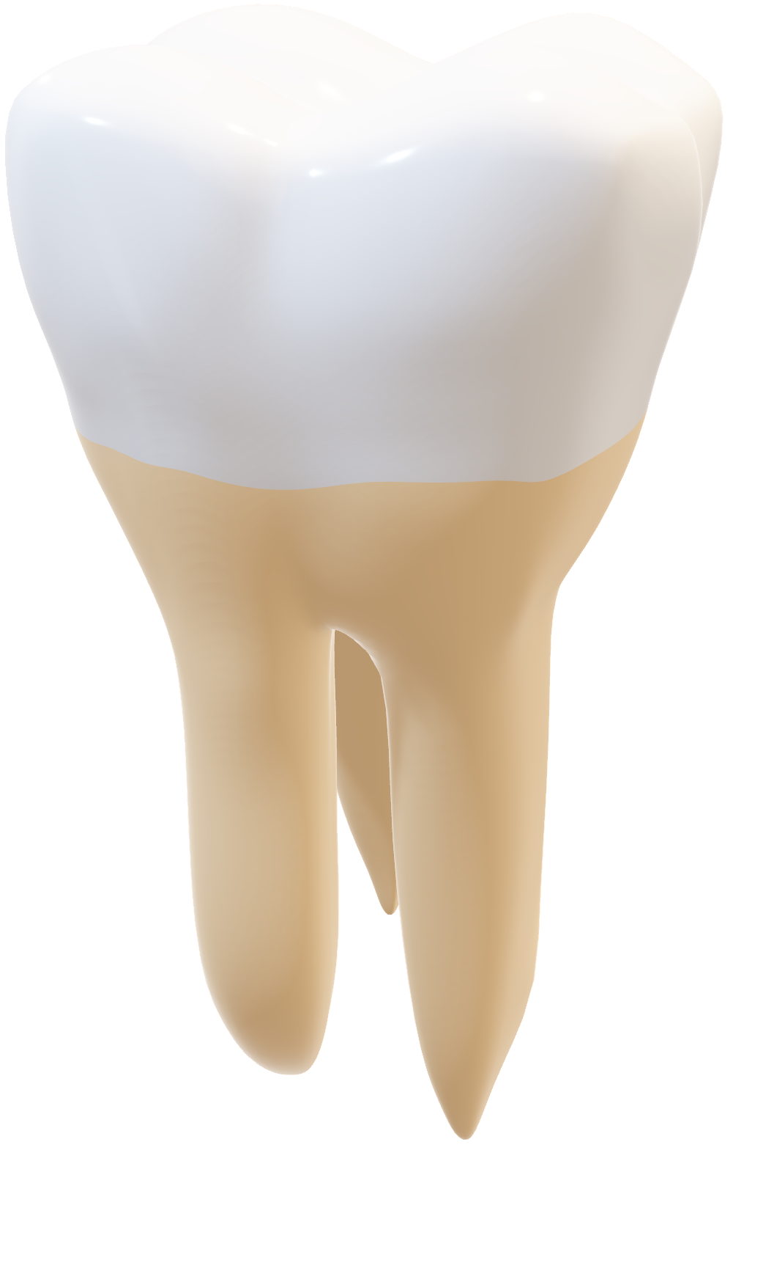

But what do people think about the idea?
We found that Egypt has around 81 dental colleges in total.
Among them, 22 belong to public (governmental) universities, 37 belong to private universities, and 22 belong to national (non-profit) universities.
Every year, around 70,000 undergraduate students study dentistry across these colleges.
As the survey that’s made from our team on Google Forms, we got 92 till now!
And to solve the past problems we came up with…

Slide 7

Thoutha

Slide 8

Thoutha
🦷 Bridging the Gap in Egyptian Dental Education and Care
The Solution: A Digital Bridge
DENTAL CASE CONNECTION SYSTEM (DCCS) (Mobile App + Web Platform)
How It Works
Patient Input: Patient describes symptoms.
AI Chatbot: Performs a preliminary diagnosis and categorizes the case (e.g., Root Canal, Cavity).
Matching: System pairs the patient with a student needing that specific training case.
Key System Guarantee:
All interactions are securely monitored via an Admin Dashboard for ethical use and privacy compliance.

Slide 9














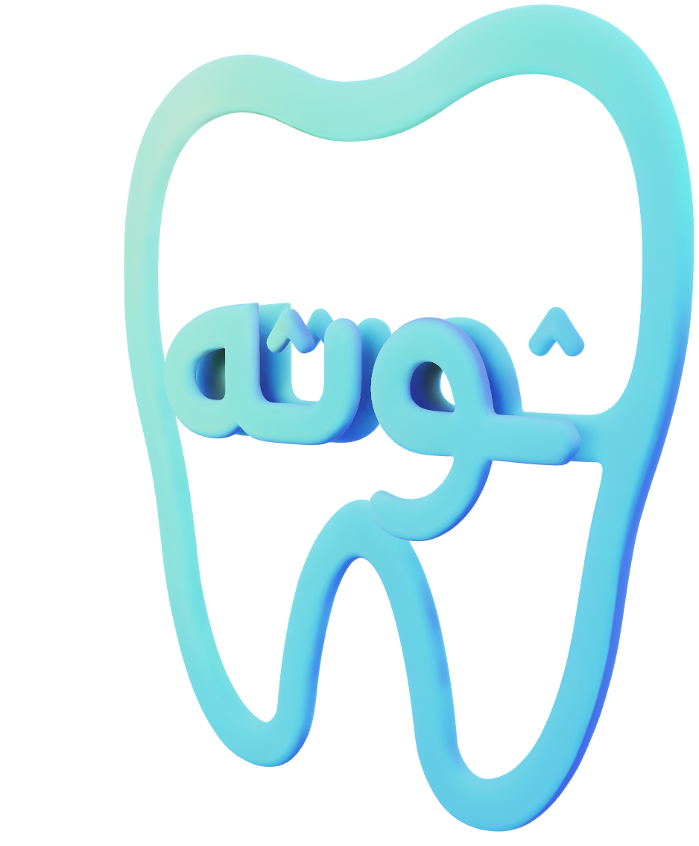
Thoutha
Technology's used :

Slide 10


Thoutha
Preparations and install :
Server setup was a critical foundation for the project. To simplify installation, maintenance, and monitoring, the Linux team developed an automated installer and unified command tools.These include install.sh and astart (All Start), enabling efficient and consistent server management.
Install.sh:
High-Level Actions
Detects and installs Oracle XE prerequisites (and Oracle itself if missing)
Ensures Python 3 + pip
Creates a Python virtual environment
Installs Python dependencies
Installs Node.js (APT systems only)
Installs a global astart launcher
Notes:
Automated installation scripts (install.sh and astart) streamline setup by handling database prerequisites, Python and Node.js environments, and ensuring consistent server deployment.

Slide 11
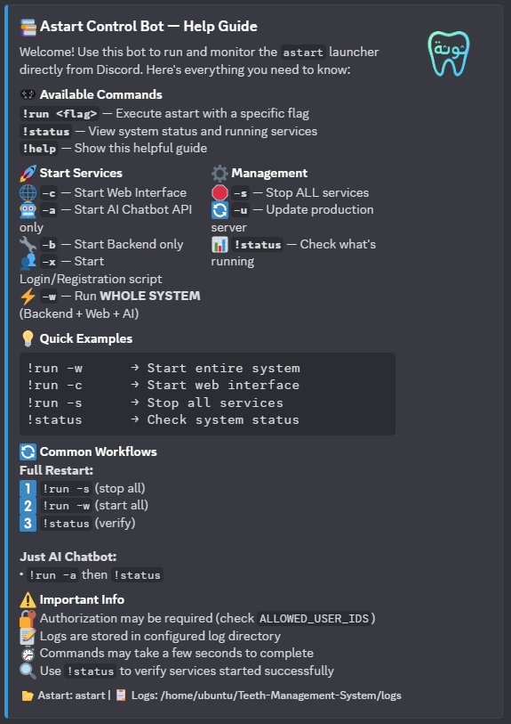
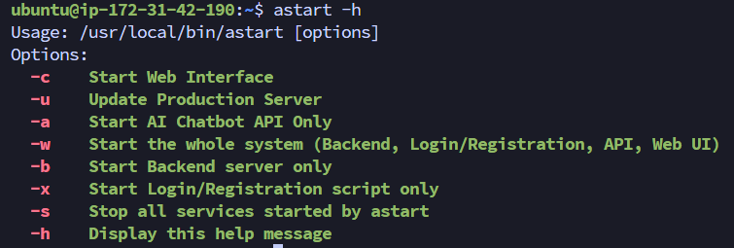

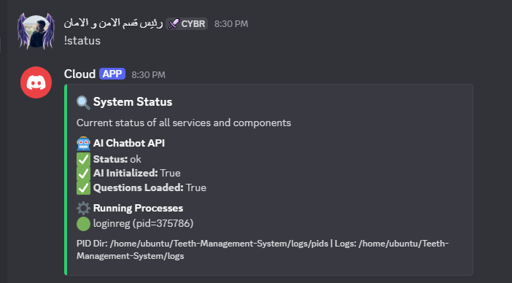

Thoutha
astart:
is a unified service orchestration and lifecycle management tool for Thoutha, responsible for controlled startup, monitoring, and shutdown of all system components.
Flags:
This script was used to integrate a Discord bot, enabling non-Linux team members to initiate testing APIs and services.

Slide 12

Thoutha
Discord
A new server management approach was introduced through a Discord bot, allowing mobile and backend developers to connect seamlessly.
It enables other team members to manage services and control APIs without directly accessing the server, improving usability and operational efficiency.
POC :

Slide 13
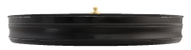
Thoutha
Challenges and problems :
Server resources are very limited (low RAM, No GPU, and low CPU cores)
Hosting a local AI model was not feasible because the application is in production phase
Chatbot depended on external API quotas (limited requests per day)
Keys exhausted → downtime & manual recovery
Our Solution:
The Key Roulette & Rule-based questions!
We engineered a custom API Key Rotation Engine:
12+ API keys combined into one smart pool
Automatic rotation when quota is reached
Real-time quota detection (429/errors)
Instant retry + failover (< 1s)
Zero manual intervention
Rule-based questions:
Chaining dental questions with the known symptoms
Determine the category / disease based on the chain
Removing load from the Ai chat-bot : Achieved!

Slide 14

Thoutha
Challenges and problems :
Server resources are very limited (low RAM, No GPU, and low CPU cores)
Hosting a local AI model was not feasible because the application is in production phase
Chatbot depended on external API quotas (limited requests per day)
Keys exhausted → downtime & manual recovery
Our Solution:
The Key Roulette & Rule-based questions!
We engineered a custom API Key Rotation Engine:
12+ API keys combined into one smart pool
Automatic rotation when quota is reached
Real-time quota detection (429/errors)
Instant retry + failover (< 1s)
Zero manual intervention
Rule-based questions:
Chaining dental questions with the known symptoms
Determine the category / disease based on the chain
Removing load from the Ai chat-bot : Achieved!

Slide 15

Thoutha
Impact & Future:
What We Achieved
Near 100% uptime
~50–60 requests/min capacity
No visible interruptions for users
Easily scalable by adding keys
Production-ready reliability
Future Plan
Upgrade server
Deploy a self-hosted/local AI model
Reduce API dependency and costs
We turned hardware limits into an engineering advantage.

Slide 16
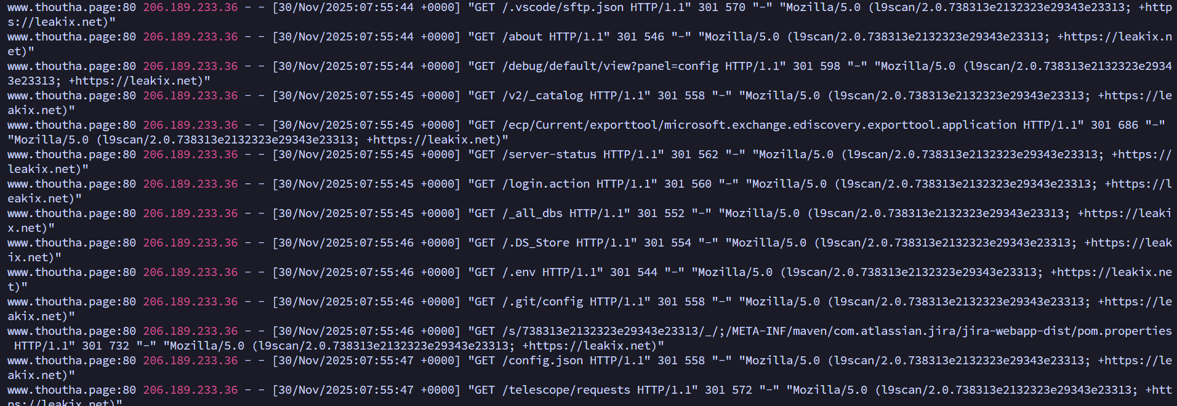

Thoutha
Security Incident Analysis & Environment Hardening:
Incident Overview
After deploying thoutha.page, the server was immediately targeted
Large volume of automated requests detected in Apache logs
Site was not publicly launched (except limited access from Egypt)
Activity flagged as abnormal and suspicious
Traffic & Attack Sources
Requests originated from multiple countries:
Sweden (highest volume)
United States, UK, Germany
Tools & bots identified:
AI crawlers
Vulnerability scanners (L9scan, LeakIX, Censys)
Indicates global automated scanning, not normal users

Slide 17

Thoutha
Observed Attack Techniques
Directory traversal attempts (/.%2e/)
Probing sensitive files:
.env, .git/config, .vscode
wp-login.php, swagger-ui
Reconnaissance & endpoint enumeration
Opportunistic scans for known vulnerabilities
No successful exploitation detected
Immediate Mitigation Actions
Deployed Cloudflare WAF
Blocked malicious paths and scanner signatures
Hardened web server using .htaccess
Disabled directory listing
Removed development and debug files from web root

Slide 18


Thoutha

Slide 19
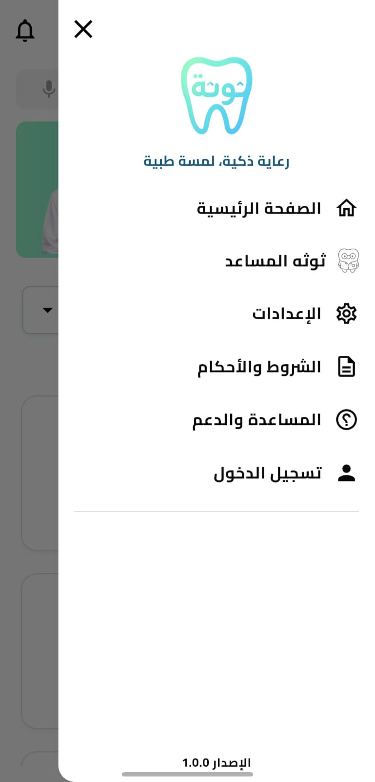
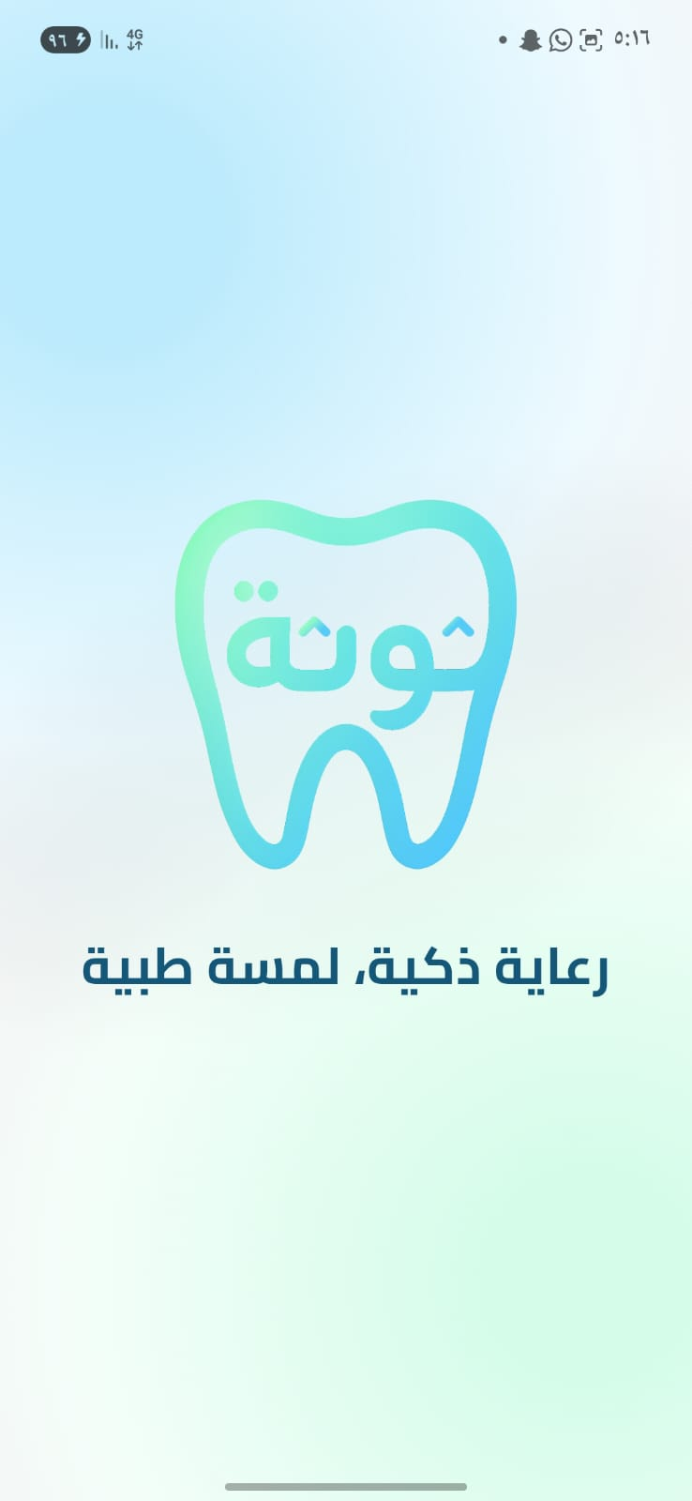
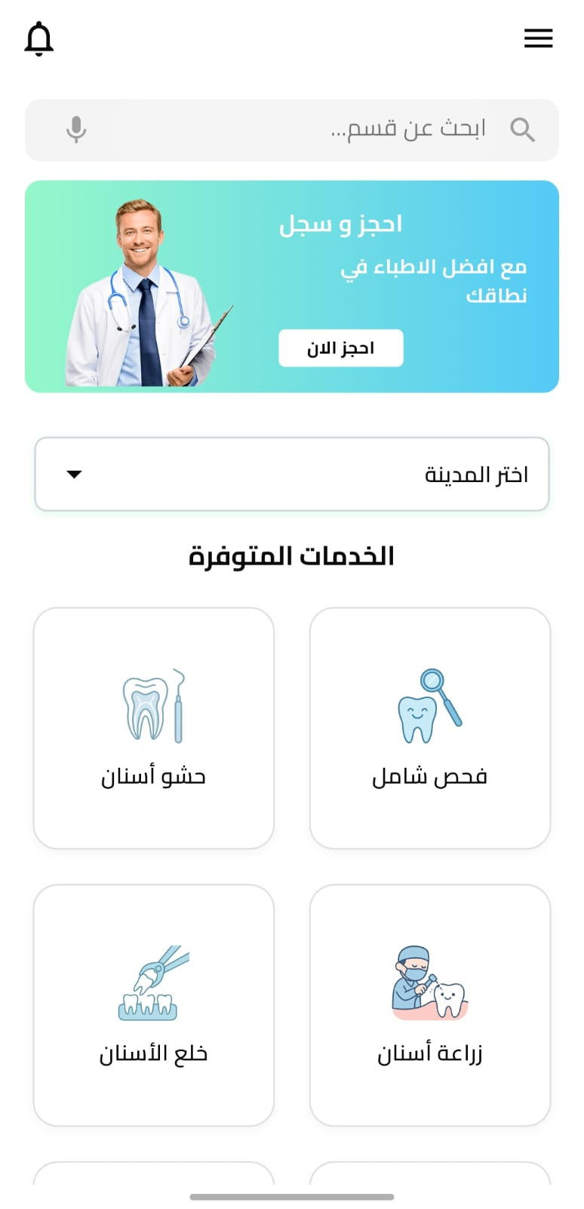

Thoutha

Slide 20
Thoutha

Slide 21
Thoutha

Slide 22
Thoutha

Slide 23
Thoutha

Slide 24

Thoutha

Slide 25

Thoutha

